Slide 1
Use Case Diagrams
U
M
L

Slide 2
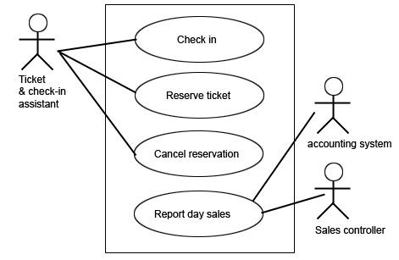

Use Case Diagrams
Category: Behavior Diagram
Capture visual overview of main of requirements.
Displays the relationship among actors and use cases
Clarify exactly what the system is supposed to do
Lists functions
Different from traditional flow chart
User’s view of a process or event
Describes a set of user scenarios

Slide 3

Use Case Diagrams
Use Case
A set of scenarios that describe an interaction between a user and a system, including alternatives.

Slide 4


Use Case Diagrams
Actors
A role that a user plays with respect to the system,including human users and other systems.
inanimate physical objects
(e.g. robot)
an external system that needs some information from the current system.

Slide 5

Use Case Diagrams
System Boundary
Rectangle diagram representing the boundary between the actors and the system.

Slide 6





Use Case Diagrams
Association
Communication between an actor and a use case; represented by a solid line

Slide 7
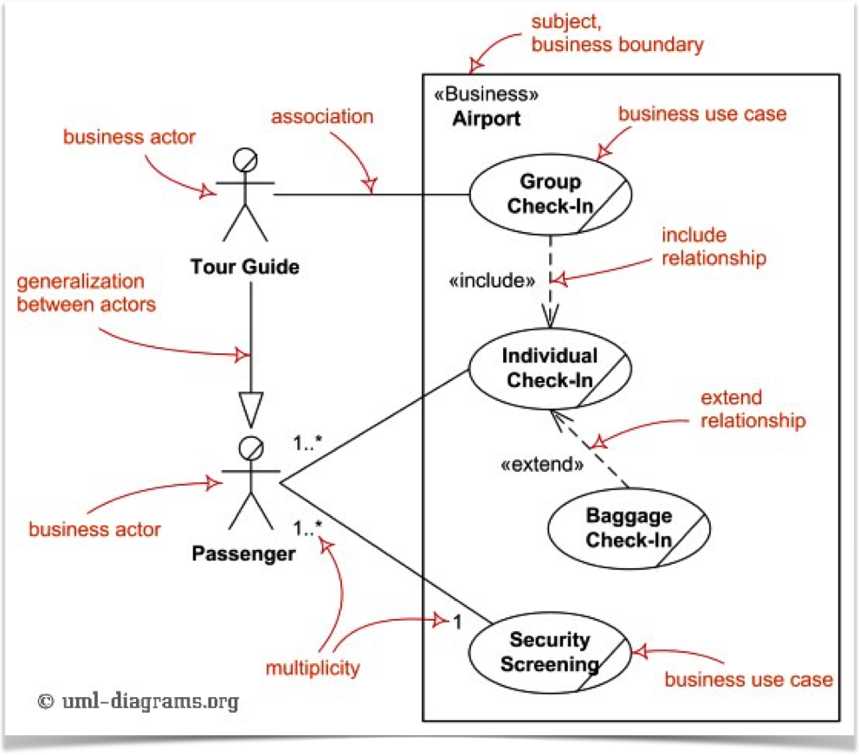

Use Case Diagrams
Generalization
Relationship between one general use case and one specific use case.
Represented by a line with a triangular arrow head toward the parent use case, the more general modeling element.

Slide 8
Use Case Diagrams
Include
Indicates a particular Use Case must include another Use Case to perform its function
A Use Case may be included by one or more Use Cases to reduce duplication of functionality
The <list orders> Use Case may be included every time the <modify order> Use Case is run

Slide 9
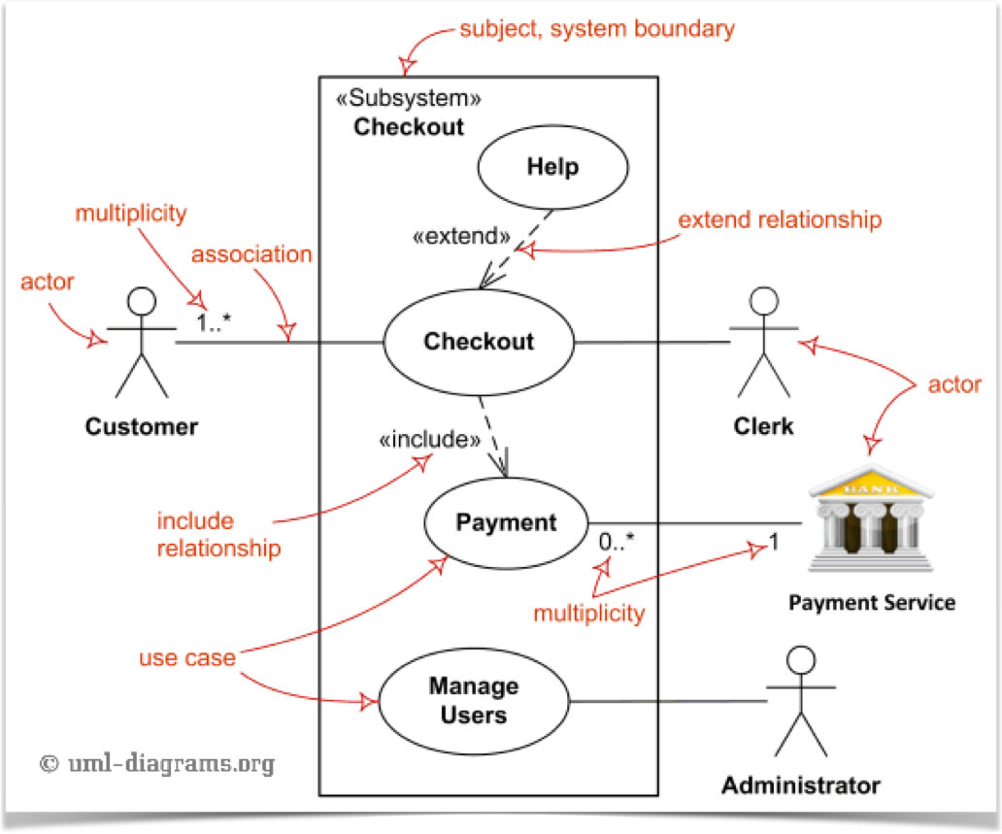
Use Case Diagrams
Extend
When exceptional circumstances are encountered the base class declares “extension points”
The extending use case may add behavior to the base use case
The <get approval> Use Case may optionally extend the regular <modify order> Use Case

Slide 10
Use Cases
U
M
L

Slide 11
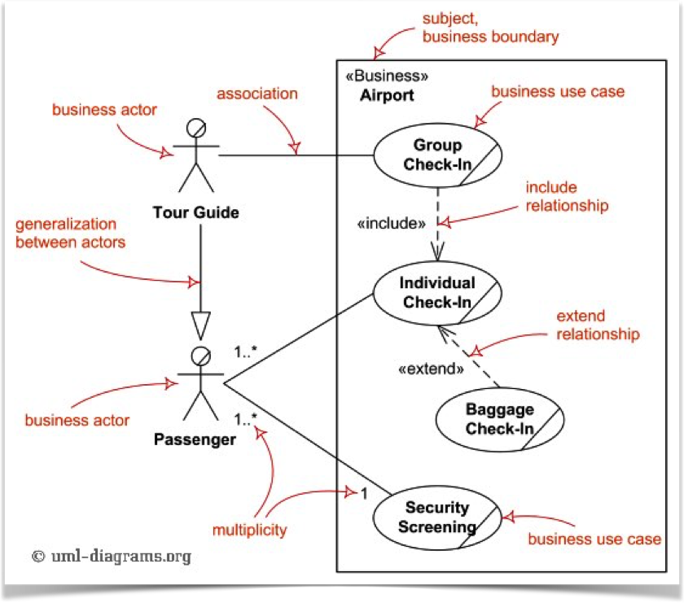
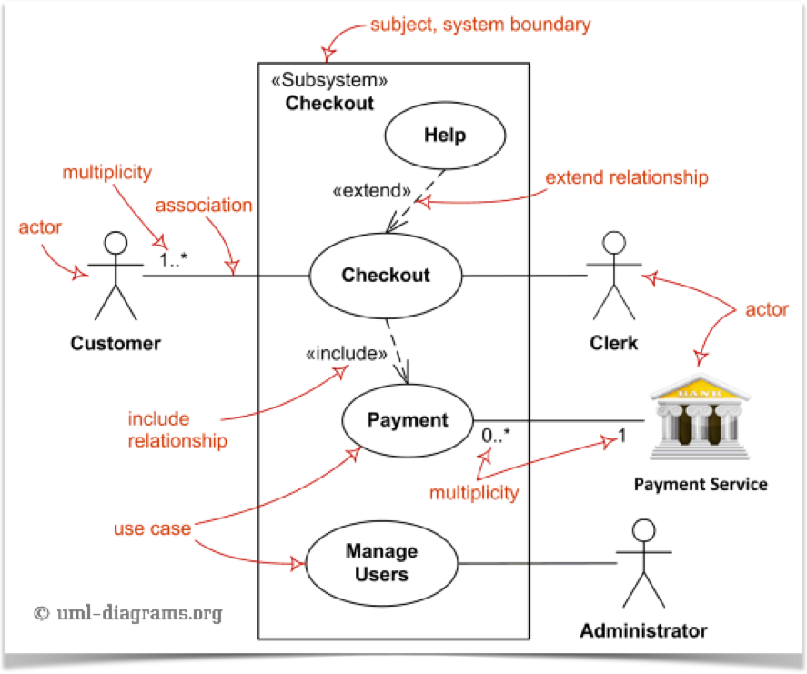
Use Cases
Business Use Case Diagrams
System Use Case Diagrams

Slide 12
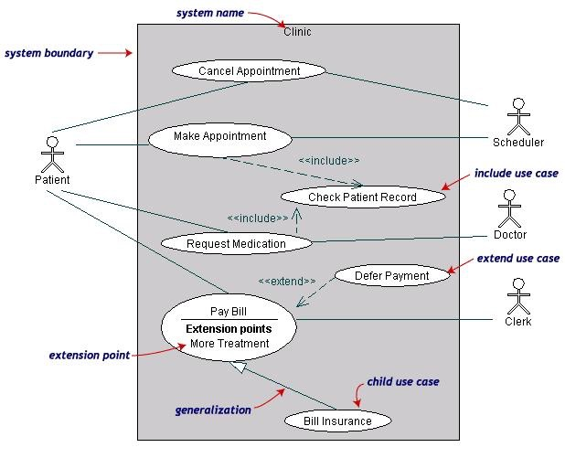
Patient Scheduling & Billing
Pay Bill is a parent use case and Bill Insurance is the child use case. (generalization)
Both Make Appointment and Request Medication include Check Patient Record as a subtask «include»
Extension point is written inside the base case
Pay bill; the extending class Defer payment adds the behavior of this extension point. (extend)

Slide 13
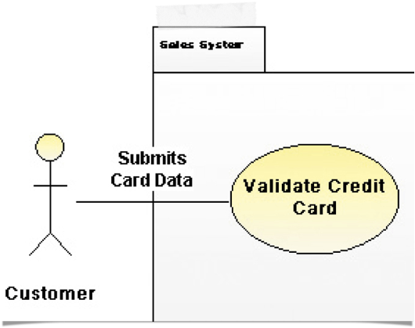
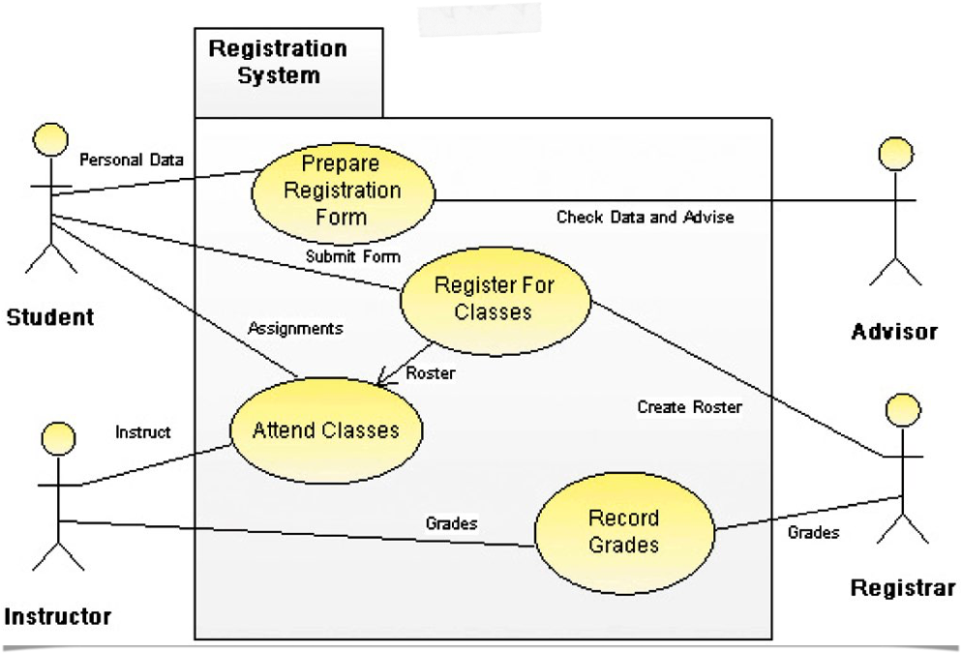
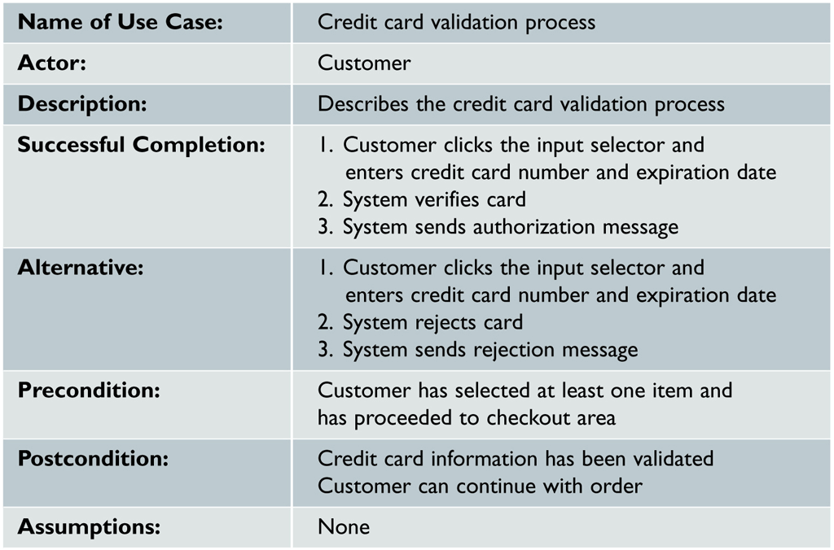
Registration System

Slide 14
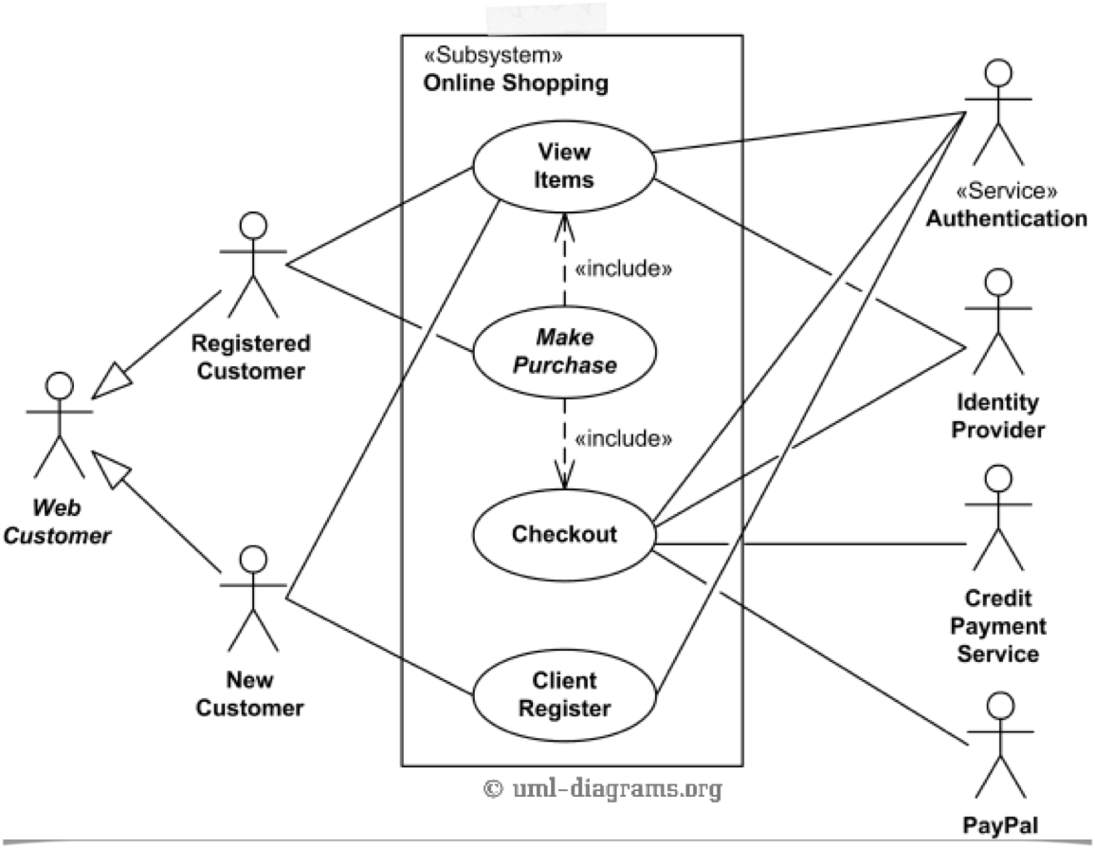
Online Shopping

Slide 15
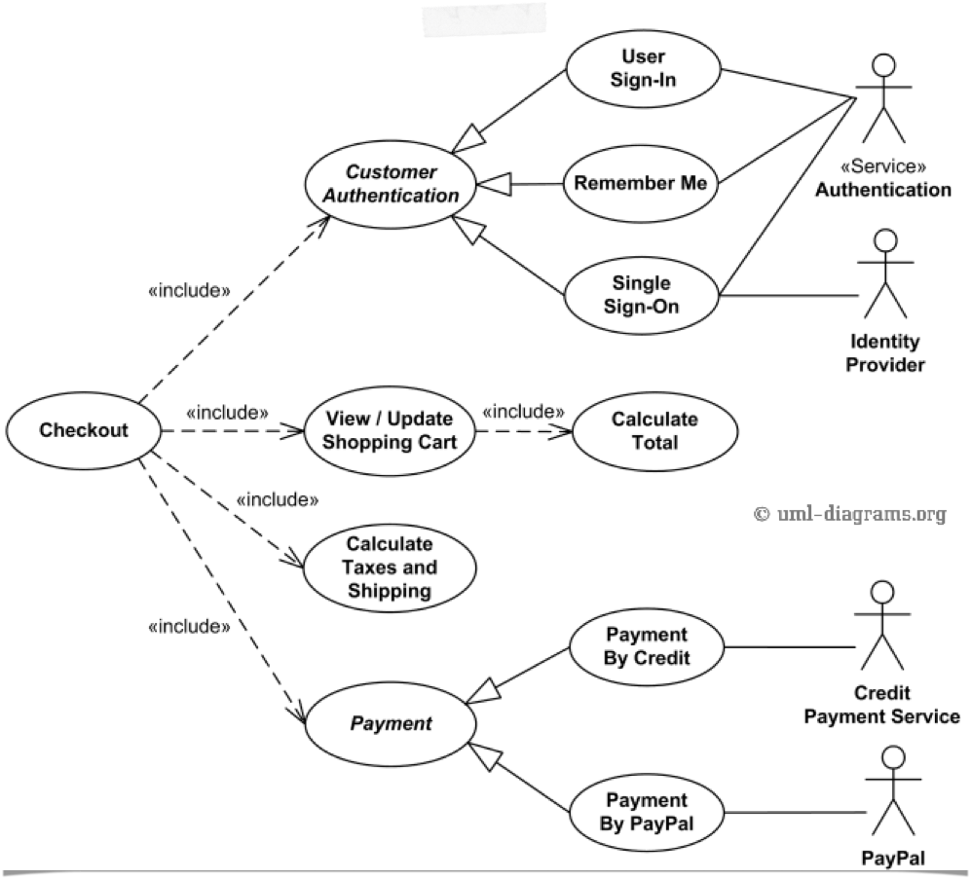
Online Shopping (Detail)

Slide 16
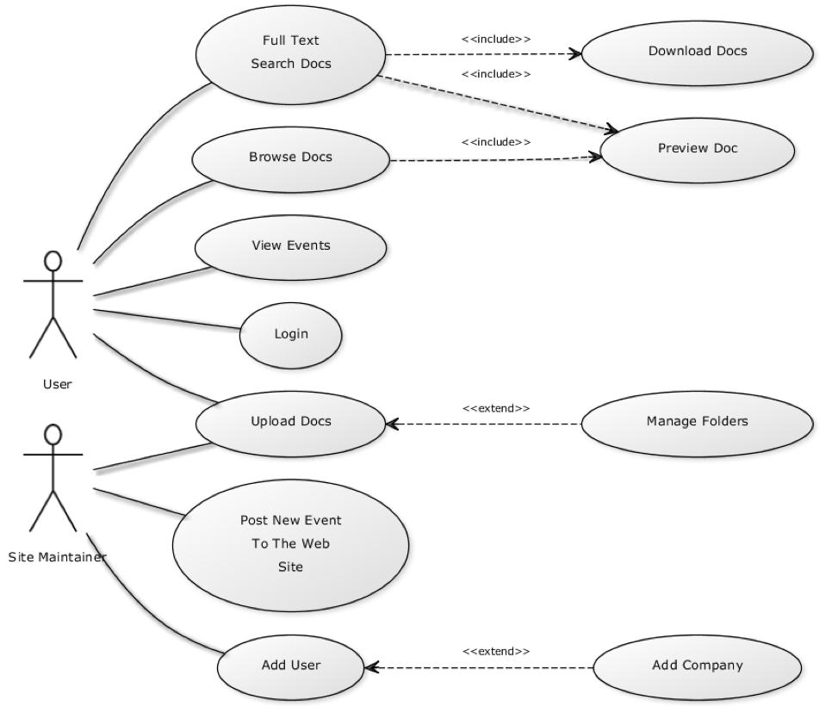
Web Content Management System

